Slide 1
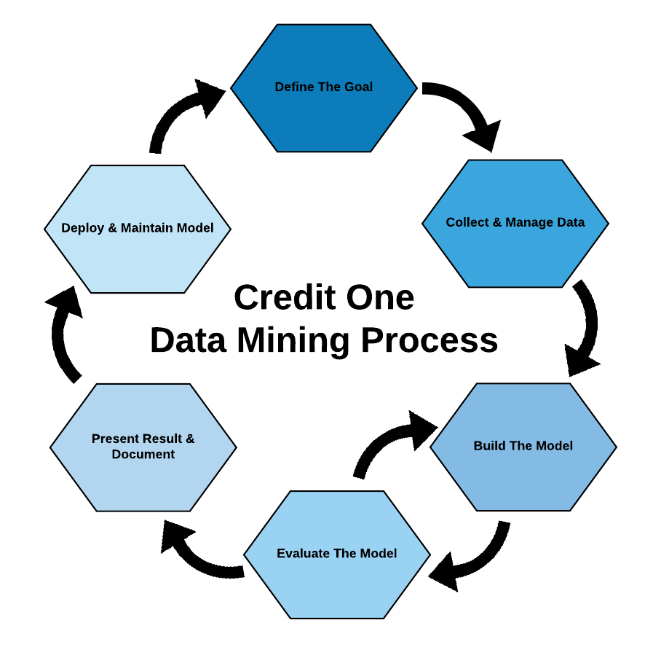

Slide 2

Define the Goal
Problem & Objective:
Credit One has seen an increase in the number of customers who have defaulted on loans they have secured from various partners and could risk losing business if the problem is not solved right away.
Using Data Science, examine current customer demographics to better understand what traits might relate to a customer defaulting on their current credit obligations.
Goal:
Understanding how much credit to allow someone.
Build a predictive model that Credit One can use to better classify potential customers as being ‘at-risk’.

Slide 3
Collect and Manage Data
Data set and attribute information provided by Credit One.
Data set consists of demographic and historical credit data of customers.
Data provided was complete, adequate and understandable but needs some clean up.
Cleaning includes:
Removing duplicate observations
Removing erroneous observations
Repayment status is incorrect in many instances – these will need to be re-calculated
Create translation table for data points, where necessary

Slide 4
Initial Findings
The dataset consisted of 60% females and 40% males.
Age range is 21 - 79 years old
70% are less than 39 years old.
82% University educated or higher.
53% single and 46% married.
Balance Limit are comparable men vs. women (160K – 170K)
26% of females & 32% of males are defaulting

Slide 5
Build, Evaluate & Critique the model
Analyze the data and extract key patterns for both business goals.
Build machine learning models to uncover and confirm data patterns.
Once a successful model has been built, we will critique it to:
Confirm results aid business goals.
Ensure insights profound. If not, re-evaluate model using new understandings.
Consider creating alternate tests to ensure model is the best.

Slide 6
Present Results Deploy & Maintain Model
All findings will be presented in a cohesive manner.
Recommendations and confidence levels will be outlined
Once finding have been presented, we will implement the recommendation using A/B testing.
Implement findings on subsets of customers to ensure positive results.
Continue to monitor results to ensure it's working as expected.
Consider collecting new data points that could be helpful to further increase accuracy.

